Slide 1
Contributors
9.30 Zoom Host, welcome & spotlighting – Shan
9.35 Zoom AV & set up Zoom in lounge – Sylivere
9.30 Sound Desk & record sermon– David A
9.45 Sound check for president, deacon, preacher, reader & intercessor
President – Beth
Deacon - Jonathan
Preacher – Michael
Reader– Gill
Intercessor – David Ryder
Warden – James
Music- David W
Crucifer - x
Chalice assistants – Boyd, Briony & Philip (only 2 needed as 3 people in sanctuary)
Banns – none
Children & family activity – Omn the green

Slide 2
Welcome to the Parish Church of St Mark
Serving the people of Broomhill & Broomhall
Living Thinking Loving Faith
The Parish Eucharist
for the Season of Giving
Sunday 13 October
at 10.00 am

Slide 3
Gathering
"Never doubt that a small group of thoughtful
committed individuals can change the world.
In fact, it's the only thing that ever has."
Margaret Mead
Introit:
Give Almes of thy Goods
Christopher Tye (1500 - 72)

Slide 4
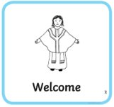
Welcome
The President is Rev Dr Beth Keith
The Deacon is Jonathan Williamson - Reader
The Preacher is Rev Dr Michael Bayley
Welcome and Singing Bowl
Followed by a period of quiet reflection

Slide 5
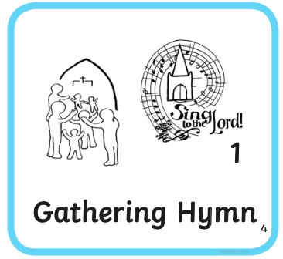
Opening Hymn
Here in this place new light is streaming,
now is the darkness vanished away,
see in this space our fears and our dreamings,
brought here to you in the light of this day.
Gather us in – the lost and forsaken,
gather us in – regardless of shame;
call to us now, and we shall awaken,
we shall arise at the sound of our name

Slide 6
Here we will take the wine and the water,
here we will take the bread of new birth,
here you shall call your children, your body,
call us anew to be salt for the earth.
Gather us in and hold us for ever,
gather us in and make us your own;
gather us in – all peoples together,
fire of love in our flesh and our bone.

Slide 7
Not in the dark of buildings confining,
not in some heaven, light-years away,
But here in this place the new light is shining,
now is the Kingdom, now is the day.
Gather us in for we are your children,
gather us in and teach us to love;
Challenge us now and help us to listen,
hearts and hands ready and willing to serve.
Marty Haugen (b. 1952)
Tune: Gather us in

Slide 8
Prayers of Approach
We gather in the name of God,
Maker, Redeemer, and Sustainer
of the Earth and all creatures! Amen.
Blessed are you, Source of all things,
to you be praise and glory forever.
As your dawn renews
the face of the Earth
bringing light and life to all creation,
bring hope to your people.

Slide 9
May we rejoice in this day you have made:
Open our eyes to behold your presence
and strengthen our hands
to work for justice for all life,
that the world may rejoice together
and give you praise.
(Adapted from Lancelot Andrewes, 1626)

Slide 10
Litany of Lament and Repentance
We sit or kneel
We confess our sin, and the sins of our society,
in the misuse of the world’s resources.
Silence for preparation

Slide 11
Generous God,
we belong to a people who are full and satisfied,
but ignore the cries of the hungry.
We enjoy the gifts of harvest,
but forget they are resources to be shared.

Slide 12
Generous God,
we are drawn by the temptations of consumerism,
but lose sight of our human value.
We enjoy the gifts of harvest,
but forget they are resources to be shared.

Slide 13
Generous God,
We store up goods for ourselves
but others are in need.
We enjoy the gifts of harvest,
but forget they are resources to be shared.

Slide 14
Generous God,
we are sorry for the times
when we have used your gifts carelessly,
and acted ungratefully.
We enjoy the gifts of harvest,
but forget they are resources to be shared.

Slide 15
May the God of love and power
forgive you and free you,
heal you and strengthen you
and give you the courage
to make a difference.
Amen

Slide 16
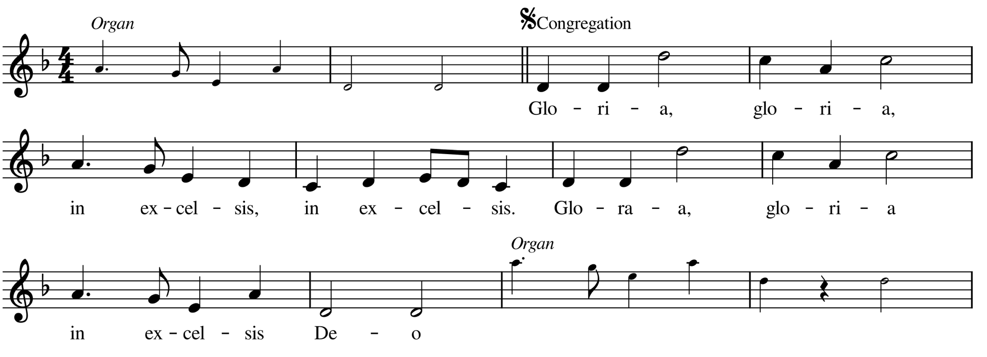
Hebridean Gloria Barbara Rusbridge
Gloria, gloria, in excelsis, in excelsis
Gloria, gloria, in excelsis Deo

Slide 17
Cantor:
Peace on earth to all your people,
Lord God heavenly King
We worship you, almighty Father,
let our voices ring!
Sing…

Slide 18
Gloria, gloria, in excelsis, in excelsis
Gloria, gloria, in excelsis Deo

Slide 19
Cantor:
Jesus, blessed lamb of God,
to you our voice we raise.
You take away our sins, O Lord,
receive our song of praise!
Sing…

Slide 20
Gloria, gloria, in excelsis, in excelsis
Gloria, gloria, in excelsis Deo

Slide 21
Cantor:
Holy Lord in highest heaven,
how our hearts rejoice.
In God the Father, Son and Spirit
so, with loudest voice,
Sing…

Slide 22
Gloria, gloria, in excelsis, in excelsis
Gloria, gloria, in excelsis Deo

Slide 23
The Collect
Generous God,
you never cease the work you have begun
and prosper with your blessing all human labour:
make us wise and faithful stewards of your gifts
that we may serve the common good,
maintain the fabric of our world
and seek that justice where all may share
the good things you pour upon us;
through Jesus Christ our guide. Amen
Common Worship

Slide 24
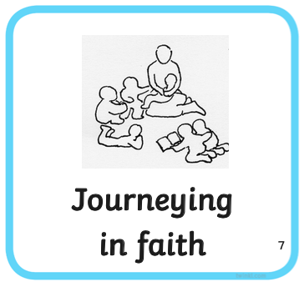
Journeying Together in Faith
As we prepare to explore God’s word,
let us pray together:
May God guide each of us in the way of Christ,
whatever our age or experience.
The love of God be with us all.
Amen

Slide 25
Attending
We sit for our first reading
First Reading: Hebrews 4:12 – end
Read by Gill MacGregor
At the end the reader says,
How is this God’s word of life?

Slide 26
Indeed, the word of God is living and active, sharper than any two-edged sword, piercing until it divides soul from spirit, joints from marrow; it is able to judge the thoughts and intentions of the heart. And before him no creature is hidden, but all are naked and laid bare to the eyes of the one to whom we must render an account.
Since, then, we have a great high priest who has passed through the heavens, Jesus, the Son of God, let us hold fast to our confession. For we do not have a high priest who is unable to sympathize with our weaknesses, but we have one who in every respect has been tested as we are, yet without sin. Let us therefore approach the throne of grace with boldness, so that we may receive mercy and find grace to help in time of need.
At the end:
How is this God’s word of life?

Slide 27
Gradual Hymn
Take my life and let it be
consecrated, Lord, to thee.
Take my moments and my days;
let them flow in ceaseless praise.

Slide 28
Take my hands and let them move
at the impulse of thy love.
Take my feet and let them be
swift and beautiful for thee.

Slide 29
Take my voice and let me sing
always, only, for my King.
Take my lips and let them be
filled with messages from thee.

Slide 30
Take my silver and my gold;
not a mite would I withhold.
Take my intellect and use
every power as thou shalt choose.

Slide 31
Take my will and make it thine;
it shall be no longer mine.
Take my heart it is thine own;
it shall be thy royal throne.

Slide 32
Take my love; my Lord, I pour
at thy feet its treasure store.
Take myself, and I will be
ever, only, all for thee.
Frances Ridley Havergal (1836 - 1879)
Tune: Nottingham

Slide 33
Gospel Luke 15:11 – 32
Hear the Gospel of our Lord Jesus Christ
according to Luke
Glory to you, O Lord.
At the end of the reading:
This is the Gospel of the Lord.
Praise to you, O Christ.
Chant: Jesus is Lord, Alleluia!

Slide 34
Jesus said, ‘There was a man who had two sons. The younger of them said to his father, “Father, give me the share of the property that will belong to me.” So he divided his property between them. A few days later the younger son gathered all he had and travelled to a distant country, and there he squandered his property in dissolute living. When he had spent everything, a severe famine took place throughout that country, and he began to be in need. So he went and hired himself out to one of the citizens of that country, who sent him to his fields to feed the pigs. He would gladly have filled himself with the pods that the pigs were eating; and no one gave him anything. But when he came to himself he said, “How many of my father’s hired hands have bread enough and to spare, but here I am dying of hunger! I will get up and go to my father, and I will say to him, ‘Father, I have sinned against heaven and before you; I am no longer worthy to be called your son; treat me like one of your hired hands.’”

Slide 35
So he set off and went to his father. But while he was still far off, his father saw him and was filled with compassion; he ran and put his arms around him and kissed him. Then the son said to him, “Father, I have sinned against heaven and before you; I am no longer worthy to be called your son.” But the father said to his slaves, “Quickly, bring out a robe—the best one—and put it on him; put a ring on his finger and sandals on his feet. And get the fatted calf and kill it, and let us eat and celebrate; for this son of mine was dead and is alive again; he was lost and is found!” And they began to celebrate.
‘Now his elder son was in the field; and when he came and approached the house, he heard music and dancing. He called one of the slaves and asked what was going on. He replied, “Your brother has come, and your father has killed the fatted calf, because he has got him back safe and sound.” Then he became angry and refused to go in. His father came out and began to plead with him. But he answered his father,

Slide 36
“Listen! For all these years I have been working like a slave for you, and I have never disobeyed your command; yet you have never given me even a young goat so that I might celebrate with my friends. But when this son of yours came back, who has devoured your property with prostitutes, you killed the fatted calf for him!” Then the father said to him, “Son, you are always with me, and all that is mine is yours. But we had to celebrate and rejoice, because this brother of yours was dead and has come to life; he was lost and has been found.”’
This is the Gospel of the Lord. Praise to you O Christ.

Slide 37
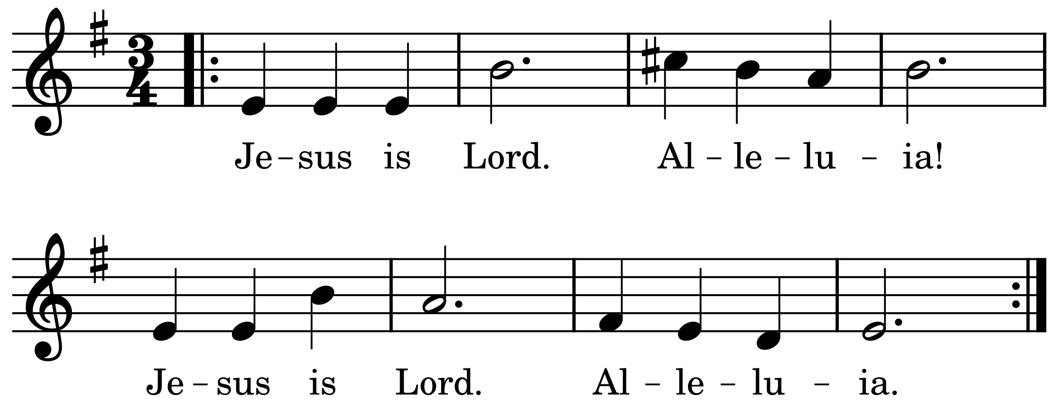
Cantor sings, all respond:
James Walsh (b.1940)

Slide 38
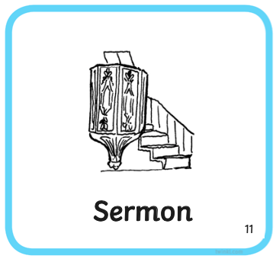
Sermon
Preacher: Rev Dr Michael Bayley
Afterwards we share a time of quiet

Slide 39
Prayers of the People (we sit or kneel)
led by David Ryder
Let us pray.
God of life and love:
Graciously hear us.
Living, suffering, loving God,
Hear us and help us
to care for your creation.
Amen.
John Schofield

Slide 40
Greeting of Peace (you are invited to stand)
Jesus said:
‘Love one another.
As I have loved you, so you are to love one another.’
The peace of the Lord be always with you.
And also with you.
We share a sign of Christ’s peace
with one another

Slide 41
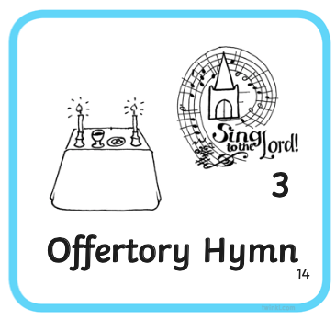
Offertory Hymn
O Jesus, I have promised
to serve thee to the end;
be thou for ever near me,
my Master and my Friend:
I shall not fear the battle
if thou art by my side,
nor wander from the pathway
if thou wilt be my guide.

Slide 42
O let me feel thee near me:
the world is ever near;
I see the sights that dazzle,
the tempting sounds I hear;
my foes are ever near me,
around me, and within;
but, Jesus, draw thou nearer,
and shield my soul from sin.

Slide 43
O let me hear thee speaking
in accents clear and still,
above the storms of passion,
the murmurs of self-will;
O speak to reassure me,
to hasten or control;
O speak, and make me listen,
thou guardian of my soul.

Slide 44
O Jesus, thou hast promised
to all who follow thee,
that where thou art in glory
there shall thy servant be;
and, Jesus, I have promised
to serve thee to the end:
O give me grace to follow,
my Master and my Friend.

Slide 45
O let me see thy foot-marks,
and in them plant mine own;
my hope to follow duly
is in thy strength alone:
O guide me, call me, draw me,
uphold me to the end;
and then in heaven receive me,
my Saviour and my Friend.
John Ernest Bode (1816 - 1874)
William Harold Ferguson (1874 - 1950)
Tune: Wolvercote

Slide 46
Abiding
Preparation
Creator God, give us a heart for simple things;
Love and laughter,
Bread and wine,
Tales and dreams.
Fill our lives with green and growing hope,
Make us a people of justice
whose song is Alleluia
and whose name breathes love. Amen.

Slide 47
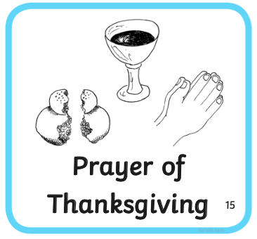
The Great Prayer of Thanksgiving
Let us pray We sit
May God be with you.
And also with you.
Lift up your hearts.
We lift them to God.
Let us give thanks to our gracious God.
It is right to give thanks and praise.

Slide 48
Lifegiving God, your word speaks in the void,
calling into being things that are not,
inviting us to share your work of creation.
We thank you for the ages long
of gathering stars
and cooling earth,
of life evolving
and waking eyes of wonder.

Slide 49
We thank you for creatures
with whom we share the world
for their lives so different from our own
and the richness they reveal.
We thank you for the Son of Man,
formed from Mary’s flesh and nurtured by her faith;
he walked the growing earth
and proclaimed a fearless kingdom
of bird and lily, child and stranger
the beggar and the blind.

Slide 50
On the cross, he joined the labour
of all creation’s yearning;
in his rising, he hallowed all flesh
to bear the glory of God;
he gives the brooding Spirit
to bring to birth a living hope.
Therefore, with all that has life through him
with animals and angels
and all who hope for a new creation,
we share the song of love which sounds from all eternity:

Slide 51
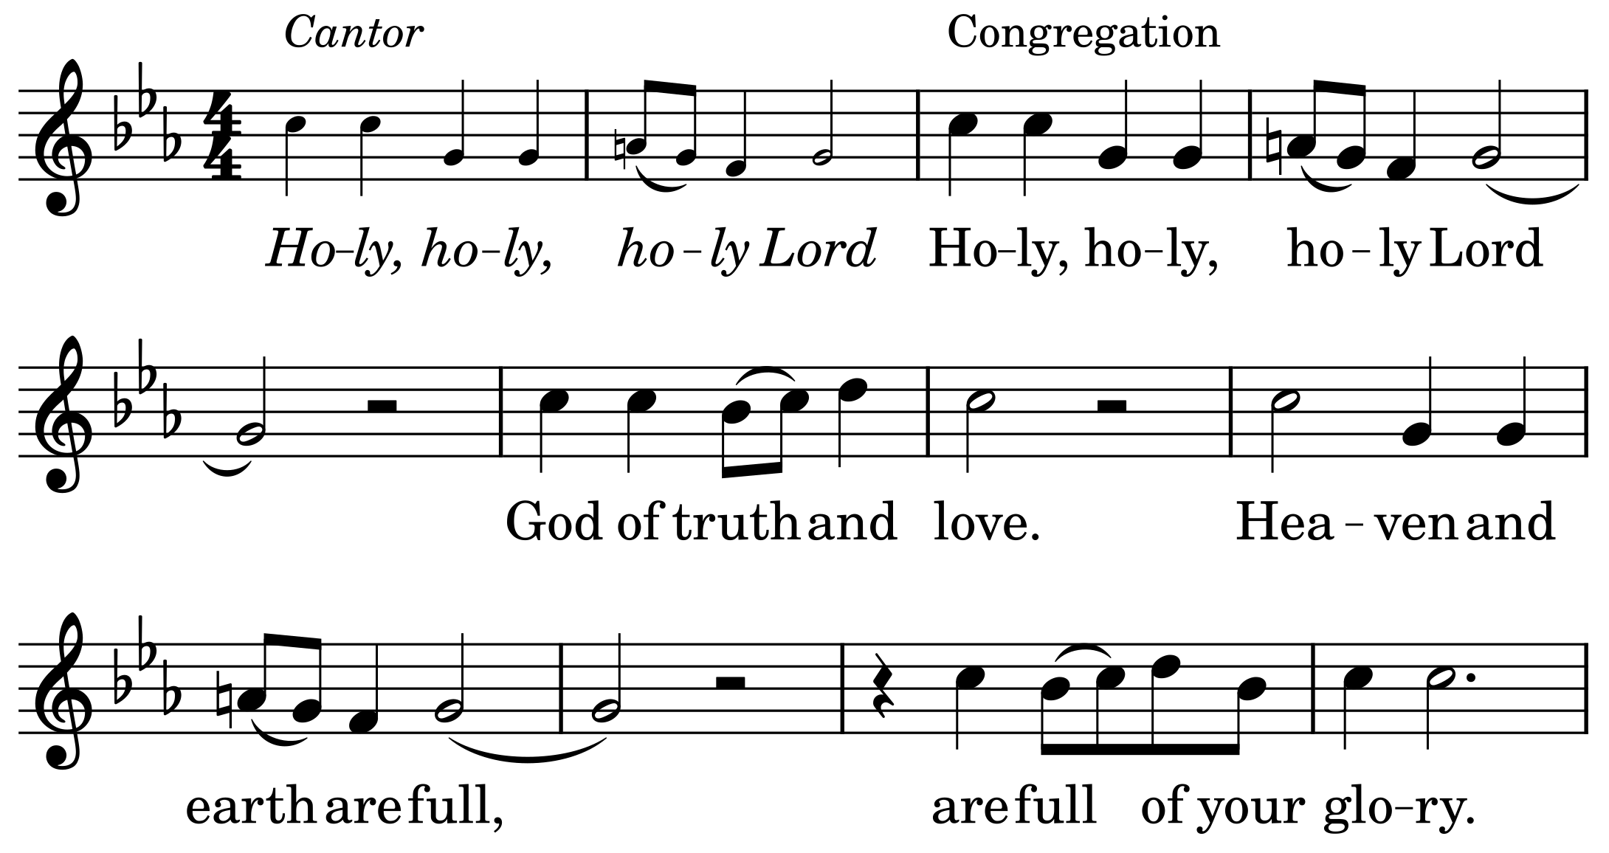
We sing the Iona Sanctus – following the Cantor’s lead

Slide 52
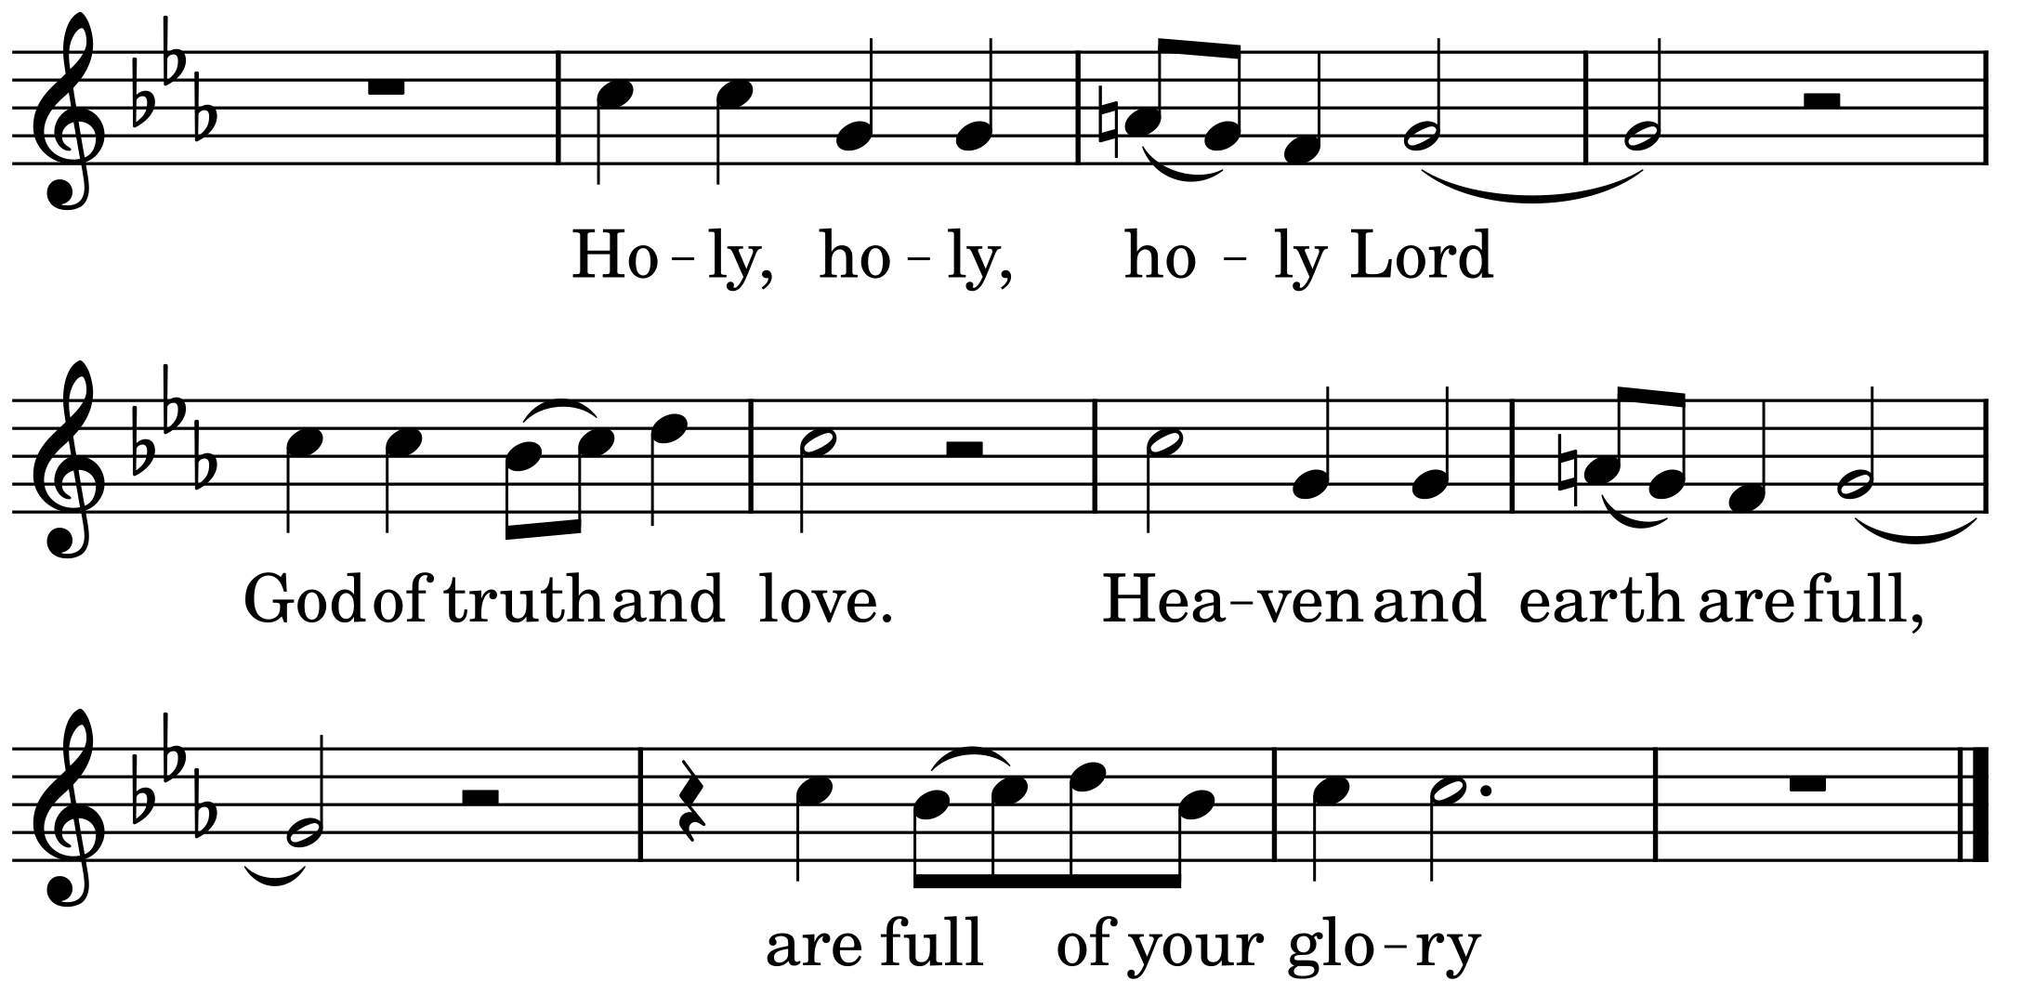
Sanctus – Iona Community

Slide 53
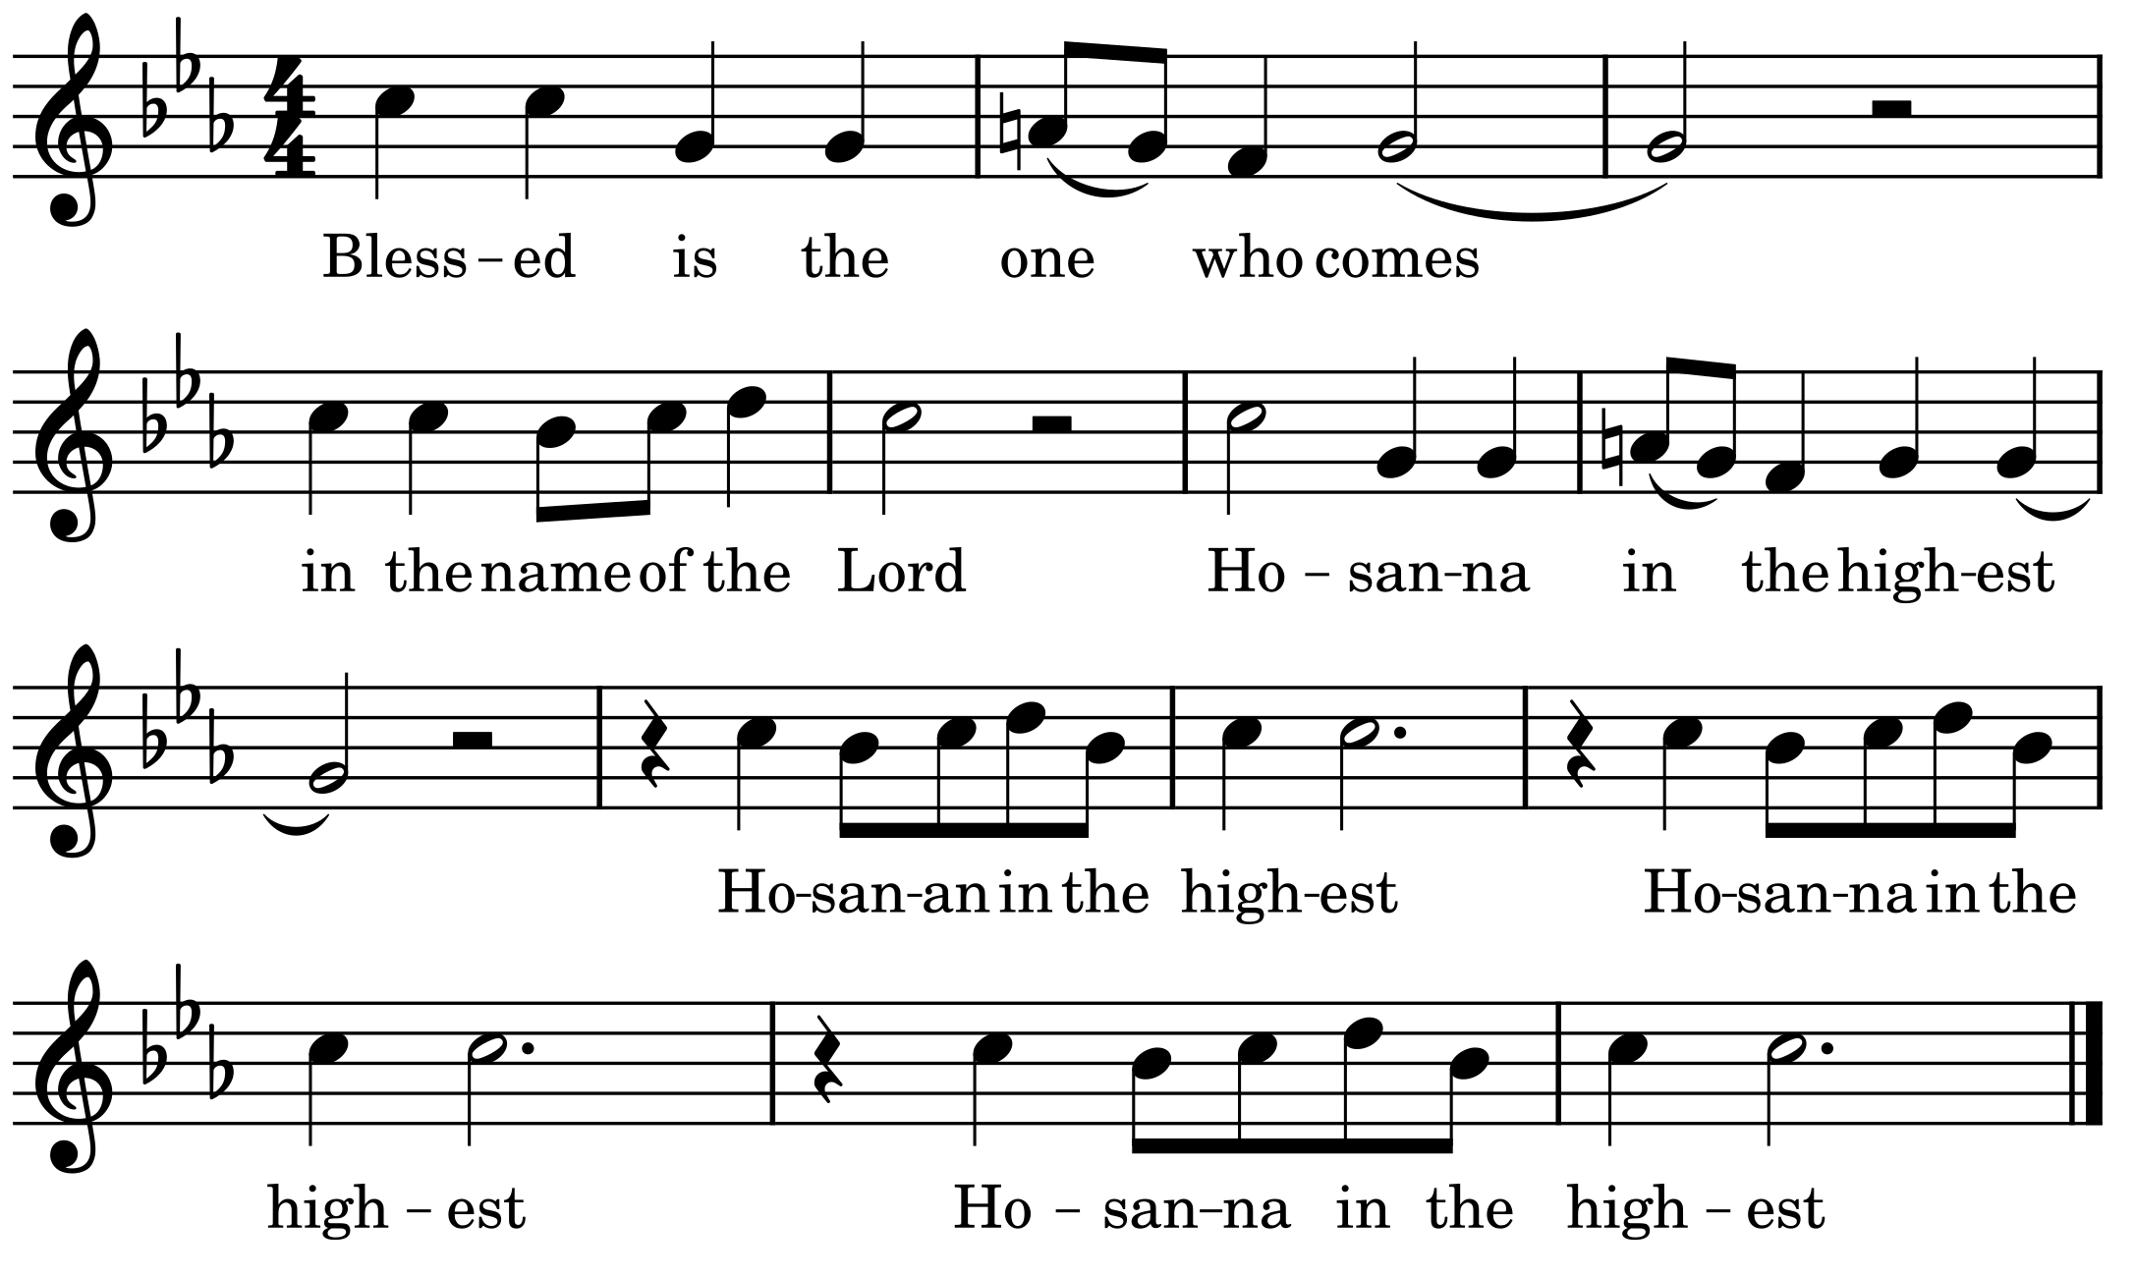
Sanctus – Iona Community

Slide 54
We ask that your Holy Spirit
will fall upon us and upon these gifts
that these fragile, earthly things
may be to us the body and blood
of our lord and brother, Jesus Christ;
who, on the night that he was betrayed,
gathered with his faltering friends
for a meal that tasted of freedom.

Slide 55
Calling them to his table,
he took bread, gave thanks, broke it and said:
This is my body, which is given for you.
Do this to remember me.
In the same way, after supper, he took the cup, saying:
This cup is the new covenant in my blood.
Do this, whenever you drink it, to remember me.
As on that night, so here and now
he offers himself in touch and taste
beyond all words can hold.

Slide 56
Great is the mystery of faith
Christ has died
Christ is risen
Christ will come again.
Therefore we come to him in whom all is created
in heaven and on earth,
whose cross and resurrection make all things new.
We offer this to you,
asking you to smile upon the gift we bring,
for you alone are the Giver and Christ’s the gift
through which we live once and for all.

Slide 57
Through him who was emptied
to bear your fullness,
we make our prayer
with Mark, John, Mary
and all who lived to the glory of God
who fills all in all now and for ever.
Amen
Steven Shakespeare

Slide 58
Lord’s Prayer & Communion
OUR FATHER in heaven,
hallowed be your name,
your kingdom come, your will be done,
on earth as in heaven.
Give us today our daily bread.
Forgive us our sins as we forgive those who sin against us.
Lead us not into temptation
but deliver us from evil.
For the kingdom, the power,
and the glory are yours, now and for ever.
Amen.

Slide 59
The bread is broken
We break this bread together
in solidarity with the brokenness of one another.
In friendship we accompany one another
towards our healing.
Holy Rood House

Slide 60
Words of invitation follow
We receive the gift of gathering:
heart to heart,
drawing power from the wells of divine strength.
We remember, we receive.
In flesh and in spirit we are one body.
Steven Shakespeare
All are welcome at the table,
to receive a wafer, dipped in wine, or a blessing. Please come forward with those around you.

Slide 61
During Communion we sing Shower, O Heavens by Eleanor Jarvis

Slide 62
The choir sings the Anthem:
Locus Iste by Anton Bruckner (1824 - 1896)
Text: Locus iste a Deo factus est, inaestimabile sacramentum, irreprehensibilis est.
Translation: This place was made by God, a priceless sacrament; it is without reproach.

Slide 63
Prayers of Commitment
Generous God,
with joy we have offered thanks for your love
and shared in bread and wine.
By grace, plant within us a reverence
for all that you give us
and make us generous and wise stewards
of the good things we enjoy;
through Jesus Christ,
Amen.

Slide 64
Announcements
The NOTICES section on our website is updated weekly
To support our ministry and outreach financially please use the card reader or visit the website for more options.

Slide 65
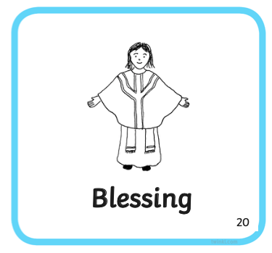
Blessing
May God give you comfort and peace
light and joy, in this world and the next.
And the blessing of God,
Father, Son and Holy Spirit
be with you always.
Amen.

Slide 66
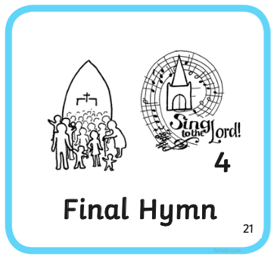
Final Hymn
Come down O love divine,
Seek thou this soul of mine,
And visit it with thine own ardour glowing;
O Comforter draw near,
Within my heart appear,
And kindle it, thy holy flame bestowing.

Slide 67
O let it freely burn,
Till earthly passions turn
to dust and ashes in its heat consuming;
And let thy glorious light
shine ever on my sight,
And clothe me round, the while my path illuming.

Slide 68
Let holy charity
mine outward vesture be,
And lowliness become mine inner clothing;
True lowliness of heart,
Which takes the humbler part,
And o'er its own shortcomings weeps with loathing.

Slide 69
And so the yearning strong,
With which the soul will long,
Shall far outpass the pow'r of human telling;
Nor can we guess its grace,
Till we become the place
wherein the Holy Spirit makes his dwelling.
Text: Bianco da Siena (d. 1434)
Tune: Down Ampney

Slide 70
Commission
We turn to face the back of church
Go in the light and peace of Christ.
Thanks be to God.

Slide 71
Voluntary
Pastorale (from concerto no. VIII)
Arcangelo Corelli (1653 - 1713)
Friendship Time
Refreshments are served at the end of the service, please stay if you can.
For those on Zoom, we hold a breakout group after the voluntary to which you are welcome.

Slide 72
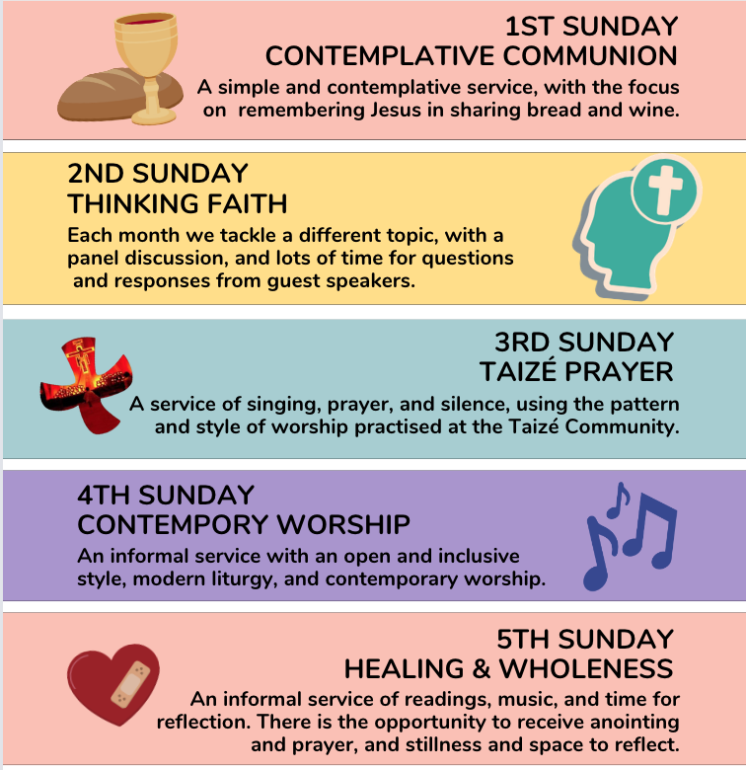
Tonight →

Slide 74
'Coffee after Coffee' - The Group for young adults meets today to explore Ecumenicalism and the world church

Slide 75
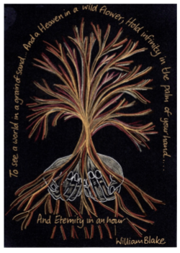
Trauma Informed Ministry: interactive workshop
by Rev Hilary Ison
Saturday 19th October
9:30 – 2:00
Here at St Mark's Church

Slide 77
Free event but please sign up . More on our website

Slide 78
Come and Sing Evensong
2:00pm - 5:30pm
Sun 24 Nov
Here at St Mark’s

Slide 79
The following sources have been used in compiling this service:
‘Common Worship: Services and Prayers for the Church of England,’ ​
and ‘Common Worship: Times and Seasons,’ copyright © The Archbishops’ Council 2000 & 2006; Patterns for Worship © The Central Board of Finance 1995 and New Patterns for Worship © The Archbishops’ Council 2005. Also, resources for Creationtide from the Church of England website; The Earth Cries Glory, Daily Prayer with Creation, Steven Shakespeare.​
Scripture quotations, unless otherwise attributed, are from the New Revised Standard Version of the Bible, Anglicized Edition, copyright © 1989, 1995. Hymns and songs are reproduced under Church Copyright Licence 887387 and OneLicense 632945. ​

